Slide 1


Project
Google maps
Supervised by : مسفر عبدالله ال دحيم
Year:2023

Slide 2
README PAGE
One of the most prominent objectives of the project is to highlight several technical and analytical aspects that include preparing it from scratch.
Based on the assumption: Why was the application designed?
Issues that existed previously before the application design and suggested solutions that were included within the application .
Then analyze the requirements and divide them into functional and non-functional depending on several things.
A brief overview of the company producing this application (Google) and the methodology by which the application was designed was mentioned.
Based on the analytical aspect, there must be several models on which the application is based, to know many of them direct stakeholders and their roles, and each role represents a process belonging to a specific database and the chronology of certain operations such as seeing maps and others.
At the end of the project, the team gained experience in technical content analysis and software analysis from the roots.
Maryam Alkhraan

Slide 3

Introduction and information about google maps
Components of the project
1
2
diagrams
Topics Covered
Conclusion
3

Slide 4
Introduction and information about google maps
introduction
problems
proposed solutions
background
functional requirements
non-functional requirements
work plan

Slide 5
Introduction
An application belonging to Google, which is concerned with geographical maps and can be represented by: When the beneficiary chooses a specific destination, the mechanism is to direct him through the fastest and least crowded road, knowing that it allows displaying data the desired place and the evaluations of other users.

Slide 6

Problems
Previously, there was a lack of explanatory information about local places, the user's inability to know and access new places, always going by the usual road, regardless of the presence of obstacles such as traffic congestion, and there is difficulty in going to new places because the user prefers to benefit from the experiences of others.

Slide 7
Proposed solutions
Provide explanatory information for local places, direct the user to the intended destination even if it is new to him, the existence of alternative methods available as an option for the user in case of obstacles, provide the user with previous experiences from other users and there is also an evaluation rate of the place (stars).

Slide 8
Background
Google is a global company based in California
The application was released in 2005 and the subject of the application is global maps
It is an application that has wide fame among millions, as the application is characterized by many useful features, including sharing your location at the moment and many

Slide 9
Functional requirement:
1-Log in by e-mail and password (Google)
2- Allow access to location
3- Display the map in its interactive nature through icons and others
4- Search for places by typing text or by voice (voice needs permission to access through privacy)

Slide 10
Functional requirement:
5- Freedom to choose the means of transportation with knowledge of the duration for each means
6- Send a report about (the presence of maintenance work on the road, traffic surveillance cameras, the place is closed or wrong)
7- Evaluation of the proposed route after arrival
8- preference for places through the favorite places box and writing comments about it

Slide 11
Non-functional requirement:
1- Not available when there is no internet
2- The performance is excellent and flexible, which leads to ease of use
3- Provides protection and privacy for user data
4- Maintenance and periodic updates to improve performance and fix error

Slide 12
Workplan
We have chosen the Agile methodology and the incremental model because it is
suitable for Google Maps, as it was initially developed in four countries and then
expanded to include all the world, the Agile allows the development of the application
flexible and fast, and the incremental model allows The ability to add features without
a negative impact on the application.

Slide 13
diagrams
activity diagram
use case diagram
sequence diagram
class diagram

Slide 14
activity diagram
in the activity diagram, We explained the user journey in the app :
We explained the user’s journey in the application, where he receives the home page and can access the world map through it. There are important icons on this page, the most important of which is the search icon, which allows the user to search using the name of the place or its coordinates The user can also search through icons for types of places, such as restaurants, hotels, hospitals, and many others After searching for a place and choosing it, the user can view a lot about the place, including information about the place, comments and ratings from previous visitors, or even pictures of the place. Through this page, he can save the place or display directions to the place and start following the route.

Slide 15
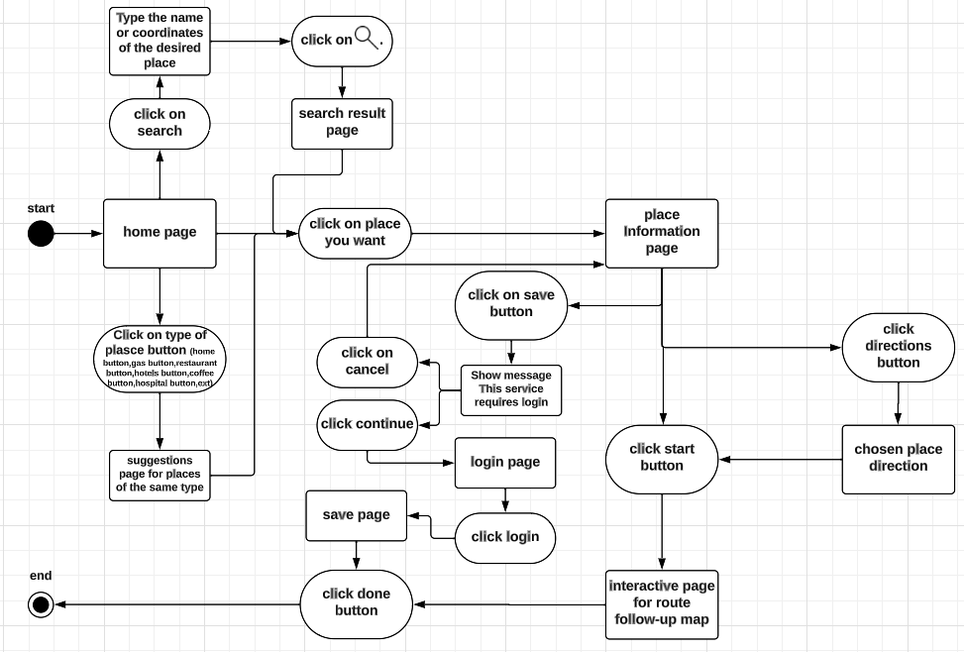

Slide 16
use case modelling
in use case modeling we took 4 main actors:
Guest user and Its most important operations are: View map - search for place - follow the specified path
Register user and Its most important operations are: login by e-mail - adding comments and ratings to a place - adding a report
Business owner and Its most important operations are: adding a commercial site - determining the opening and closing time - Selling a ticket to enter
Developers and Its most important operations are: accepting trusted commercial sites - adding map updates(new areas) - deleting offensive comments

Slide 17
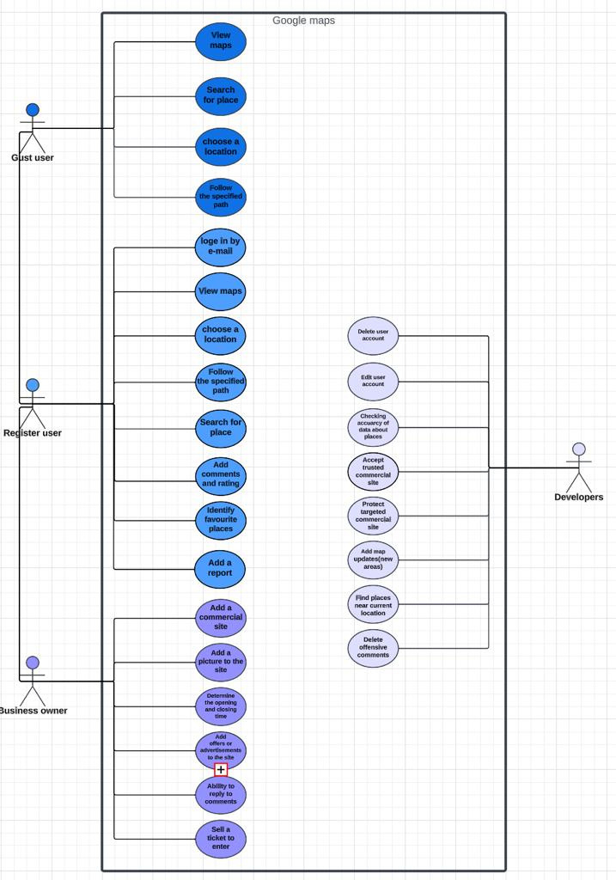
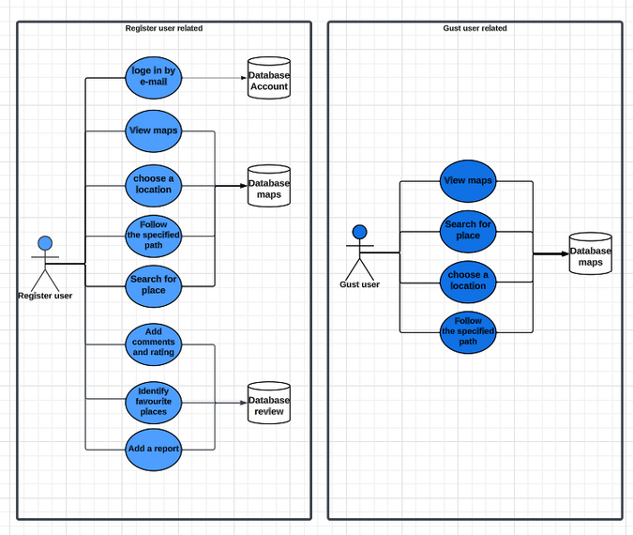
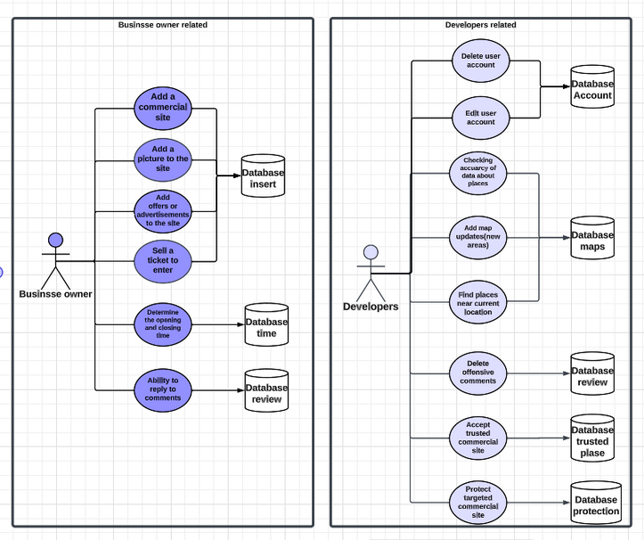

Slide 18
Sequence diagrams
In sequence diagram, we explained the chronology of some of the possible events in the application, such as the process of choosing a place
In this event, the user opens the application, and the home page is displayed to him. Then he chooses a place, and the data of the chosen place is sent to the database to verify its validity and is displayed if it exists. Otherwise, a message of non-existence is displayed.

Slide 19
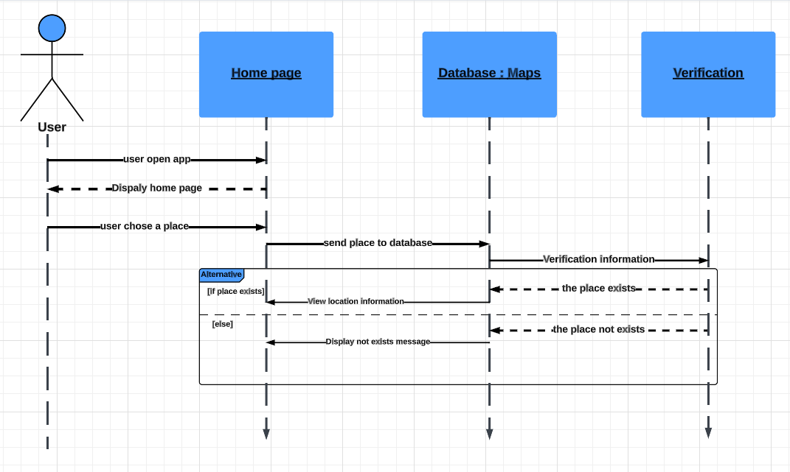

Slide 20
class diagram
In class diagram, we have explained the most important classes that will be used in programming the application, and the relationships between them have been clarified, mentioning the characteristics of each class and the method used in it.
the class we have use:
search
Roads and streets
Place
Business information
way to reach the destination
Type of transportation

Slide 21
for example in search class
the methods we have use are :
search by name()
search by coordinates()
search by place type()
and the attributes we have used are :
coordinates :float
place name :string
Icon types :string

Slide 22
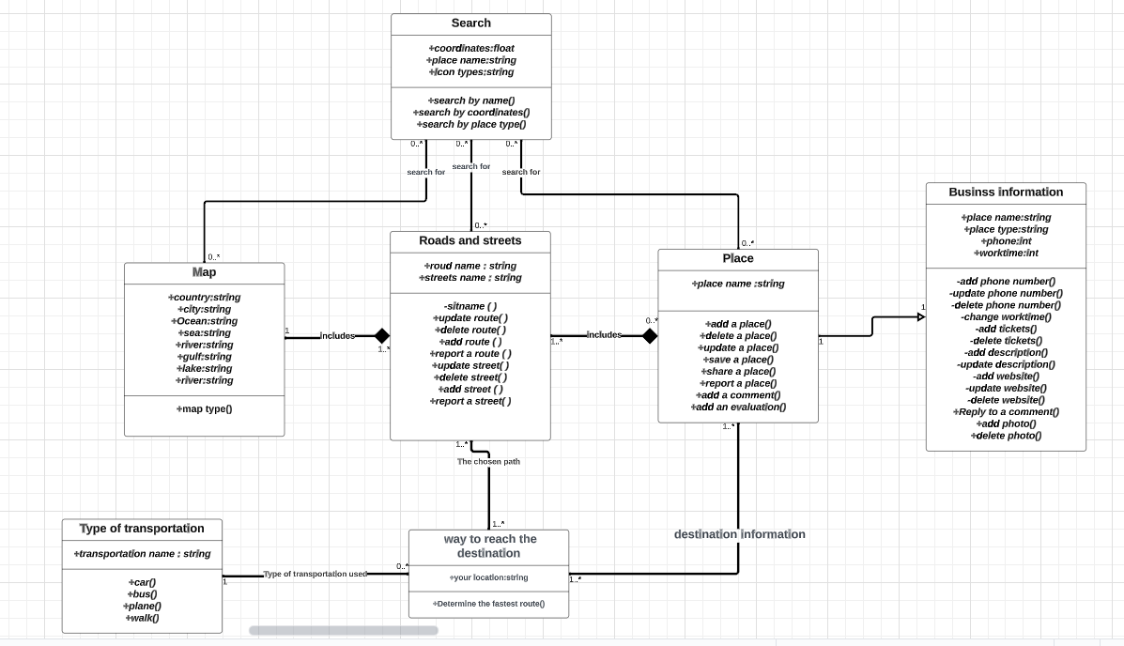

Slide 23
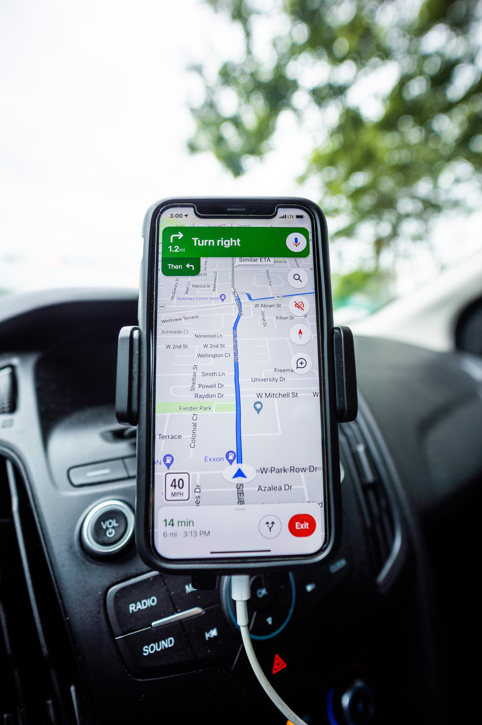
Conclusion
At the end of our project, we hope that we have summarized and provided benefit in the analytical aspect of the Google Map application, and we have gained good experience in software analysis in terms of identifying requirements of all kinds and the relationships between the actors and the database to which they belong and we have learned about the most important classes and methods for each class, which in turn facilitates us to write code( the program)
Google Maps still has many advantages that an individual cannot realize as it is a vast and constantly renewed application.

Slide 24
Thank you!
مريم إبراهيم الخرعان
نورة راشد آل صقر
سارة عبدالله ال محيميد
غدير نفل الصخابرة

